Slide 1
Real Autobots and Decepticons
Programming a Self-Reconfiguring Robot
Notes:
Presenter: Carter
(30 seconds) Be sure to introduce team

Slide 2
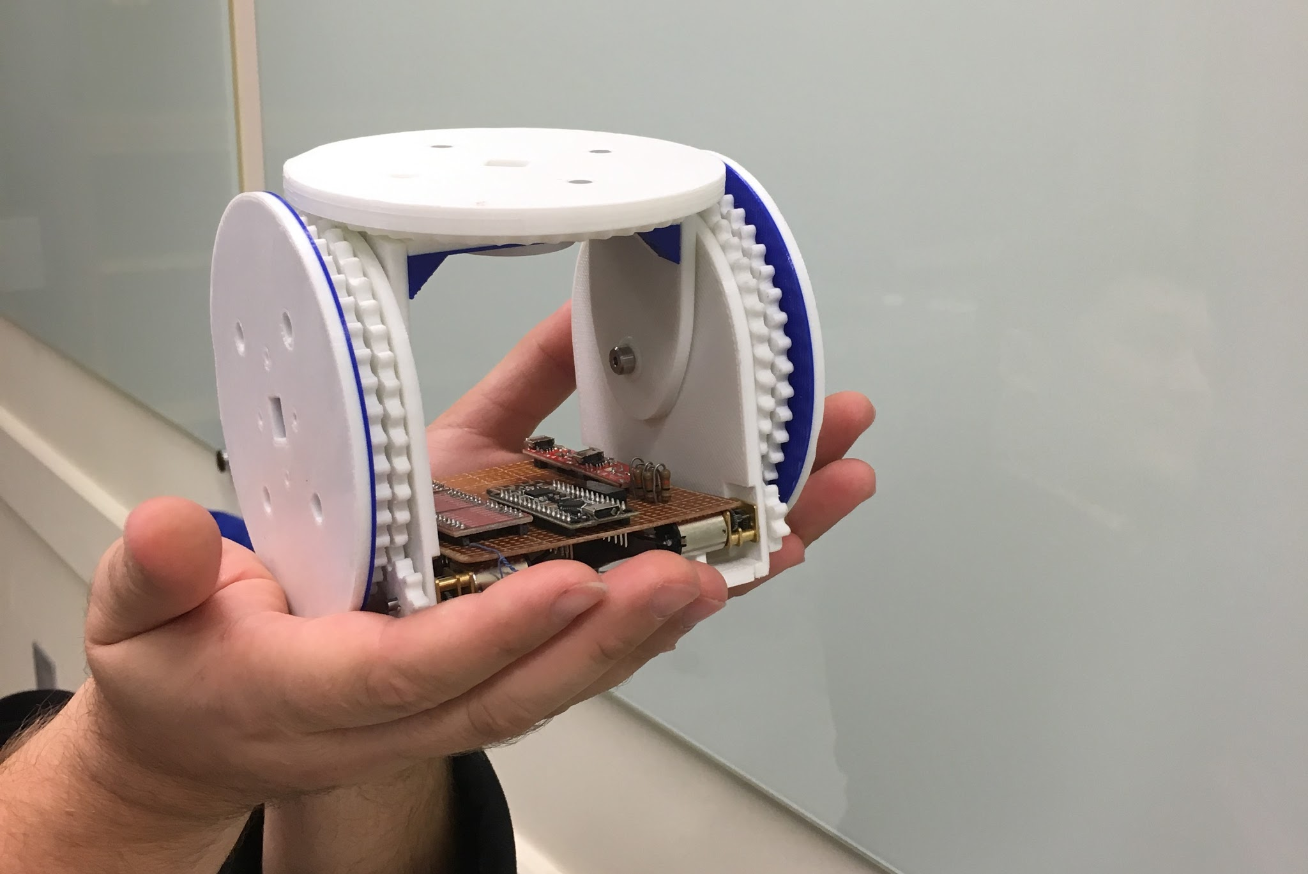
Oh, Happy Day! oh, happy day!
Notes:
Presenter: Carter
(30 seconds) Announce robot

Slide 3
Problem Statement
Unaided organization of modules into a predetermined formation from random starting points.
Notes:
Presenter: Jeff
(30 seconds) Emphasize what this actually means, ex: “we want to toss a bunch of these guys in a ring and they can automatically find each other and arrange.”

Slide 4
Requirements
Arena for robot formations
Simulator model of robots
Robot control API
Control application for facilitating AI-robot communication
AI algorithms for 2-3 configurations
Notes:
Presenter: Ben
(1 minute) Summarize requirements

Slide 5
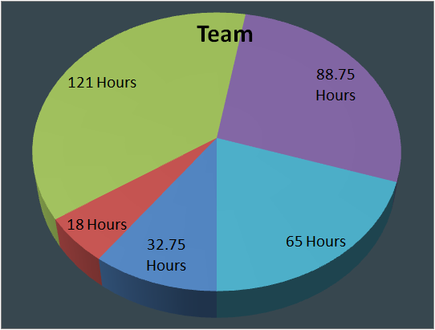
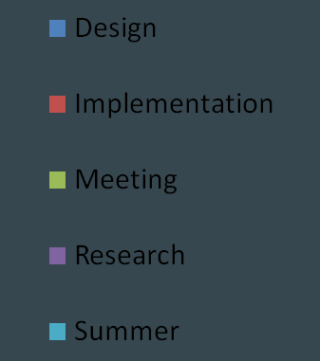
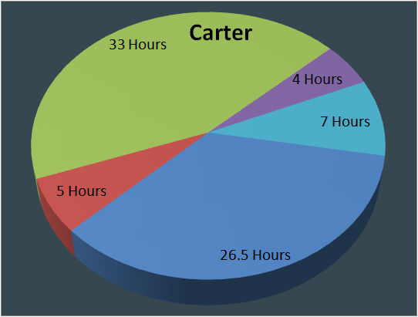
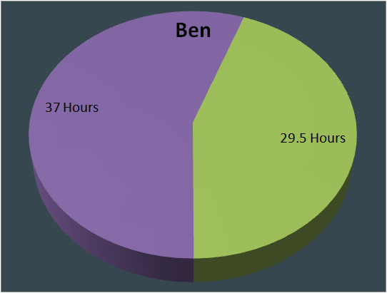
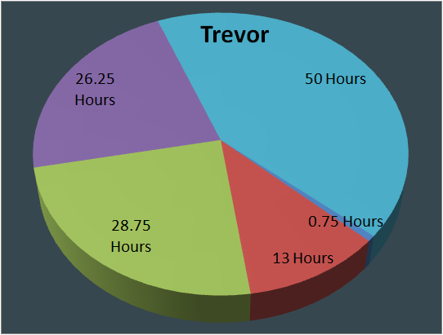
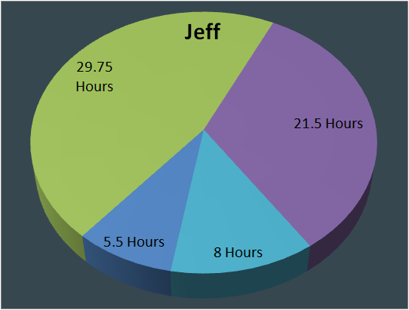
Fun Stats
Notes:
Presenter: Trevor
(30 seconds) On track for about 450 hours in the semester

Slide 6
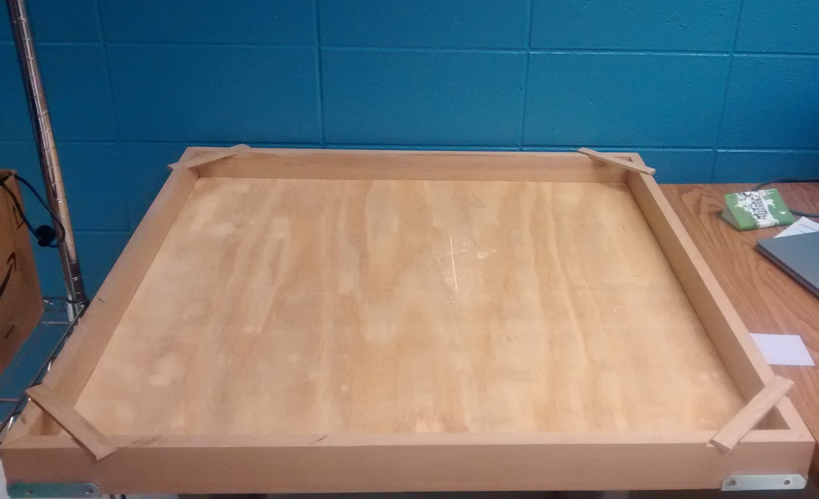
Looking Back
Built an Arena
Notes:
Presenter: Carter
(30 seconds) Talk about the purpose of the arena, placement of cameras, and reason for external sensors.

Slide 7
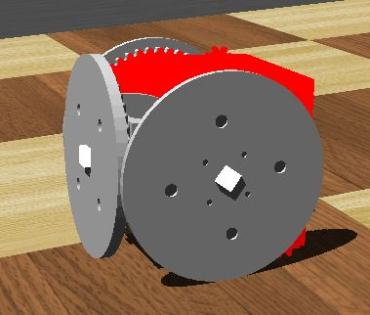
Looking Back
Completed Preliminary Simulator Model
Notes:
Presenter: Jeff
(30 seconds) Talk about how you made the model

Slide 8
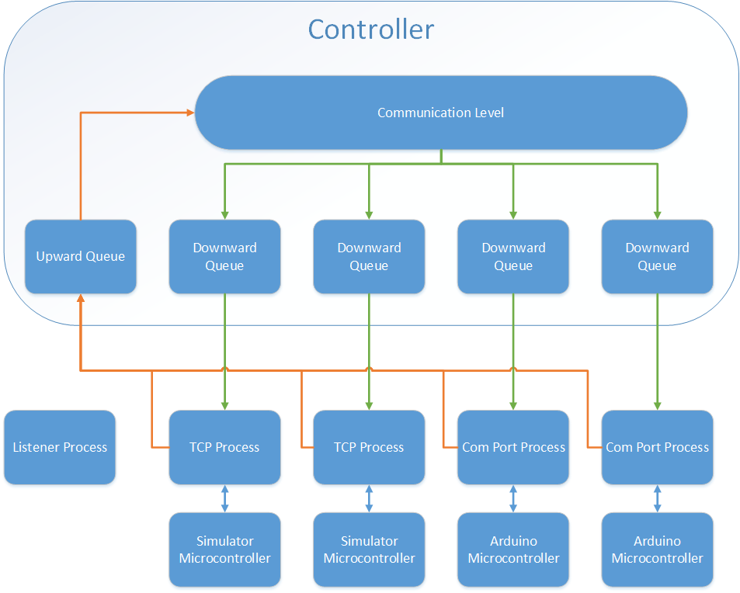
Looking Back
Implemented Communication Level of Control Application
Simulator-controller
Arduino-controller
Notes:
Presenter(s): Trevor & Ben
(2 minutes) Talk about diagram, queues, multi processing, discovery process, and difference between simulator and arduino communication.

Slide 9
Roadblocks
Robot Expectations
Simulator-Controller Communication
Multithreading with PySerial
Notes:
Presenter(s): Everyone
(2 minutes)
Carter talks about point 1 and the disaster with the robot selection.
Ben talks about point 2 and the trouble we’ve had with simulator communication
Trevor talks about the Multithreading with PySerial.

Slide 10
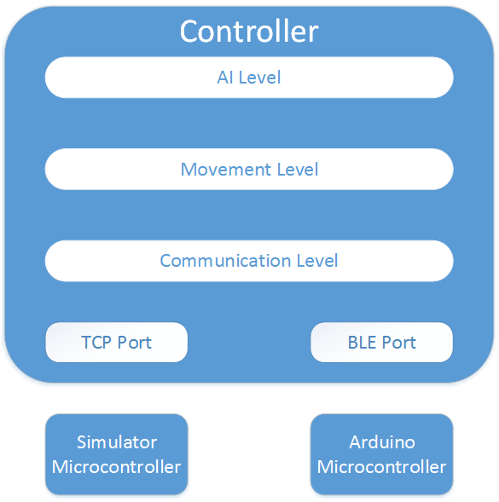
Looking Forward
Program the AI
Design World Representation
Program Movement Level
Program the Robot API
Refine the Simulator Model
Rig Arena with Cameras
Notes:
Presenter(s): Everyone
(1 minute)
Carter talks about point 1 & 2.
Trevor talks about point 3 & 4.
Jeff talks about point 5 & 6.

Slide 11
Q & A
Notes:
(3 Minutes)

